Slide 1

Hotel
Reservation
System
G . Aishwarya
Date : 07-01-2026

Slide 2

Project Overview
Problem Statement
Key Features
Technology Stack
System Architecture
ER-Diagram
Dashboard Screenshots
steps of reservation Booking lifecycle
reservation Booking lifecycle
Room service Feature Demo
Reports and Analytics
Functional Requirements & Summary
Results and Achievements

Slide 3
Project Overview
Objective:
Develop a full-stack hotel reservation system that digitizes the complete booking lifecycle, including guest registration, real-time room search, and reservations.
Streamline hotel operations for guests and staff through check-in/check-out processing, service request handling, and automated billing.
Provide secure, role-based dashboards for receptionists, managers, and admins to manage rooms, track revenue, and monitor hotel performance in real time.

Slide 4
Project Overview
Technology Stack:
Backend: ASP.NET Core 8.0 Web API (C#)
Frontend: Angular 18 (Standalone Components, Angular Material)
Database: Microsoft SQL Server
Authentication: JWT (JSON Web Tokens) with Role-Based Access Control
Duration: 10 Days

Slide 5
Problem Statement
Hotels are still using manual or semi-automated systems, which cause booking errors and inefficient room usage.
There is no real-time view of room availability, occupancy, or revenue for management.
Guests experience delays and confusion due to disconnected booking and check-in processes.
A centralized and secure hotel reservation system is needed to streamline operations and improve the guest experience.

Slide 6
Key Features
RBAC Security
Secure role-based access for Admins, Staff, and Guests.
Real-Time Search
Instant availability engine preventing double-bookings.
Dynamic Pricing
Automated seasonal rate adjustments for revenue optimization.
Service Portal
Direct digital request system for room service and housekeeping.

Slide 7
Key Features
Walk-In bookings:
Rapid, dedicated booking interface for front-desk staff.
Auto-Billing: Instant invoice generation with consolidated service charges.
Live Analytics:
Real-time dashboards for occupancy and revenue tracking.
Smart Notifications:
Automated alerts for booking confirmation and check-out reminders.

Slide 8




Technology Stack
Backend
Developed using ASP.NET Core Web API
Layered Architecture: Controller • Service • Repository
Ensures: Maintainability, scalability & clean code separation
Unit Testing: Implemented using xUnit
Frontend
Built using Angular
Modular architecture for scalability
Auth Guards & Interceptors for secure routing and API communication
Reactive Forms for reliable form handling
Angular Services + HTTPClient used to connect with backend APIs
Roles
Admin: Manages users,hotels,rooms
Manager: Manage rooms and Confirms reservation
Receptionist: Check-in,check-out,Walk-in bookings
Guest:book rooms,request for services
Database
SQL Server managed via Entity Framework Core, storing relational data for Users, Grievances, and Departments.

Slide 9
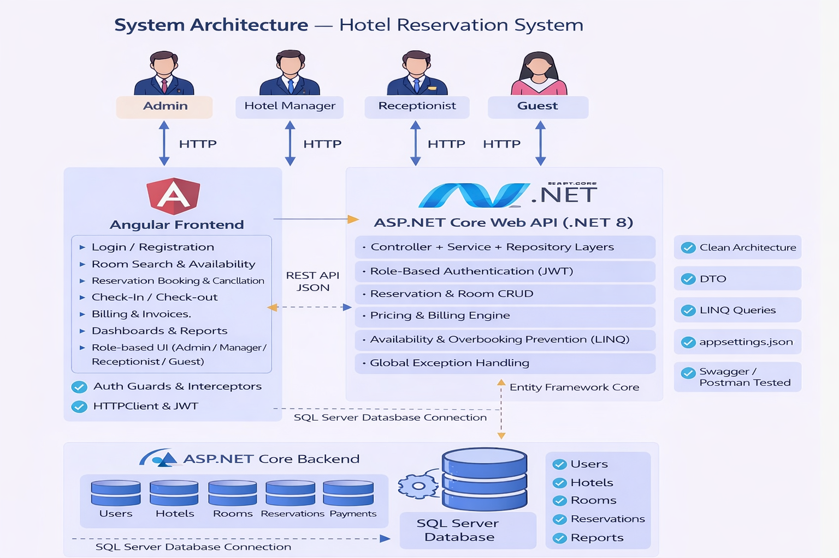
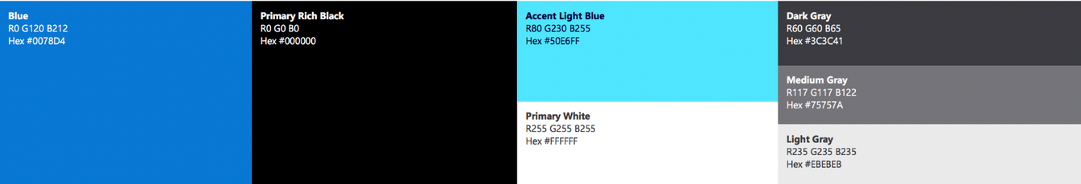
System Architecture

Slide 10
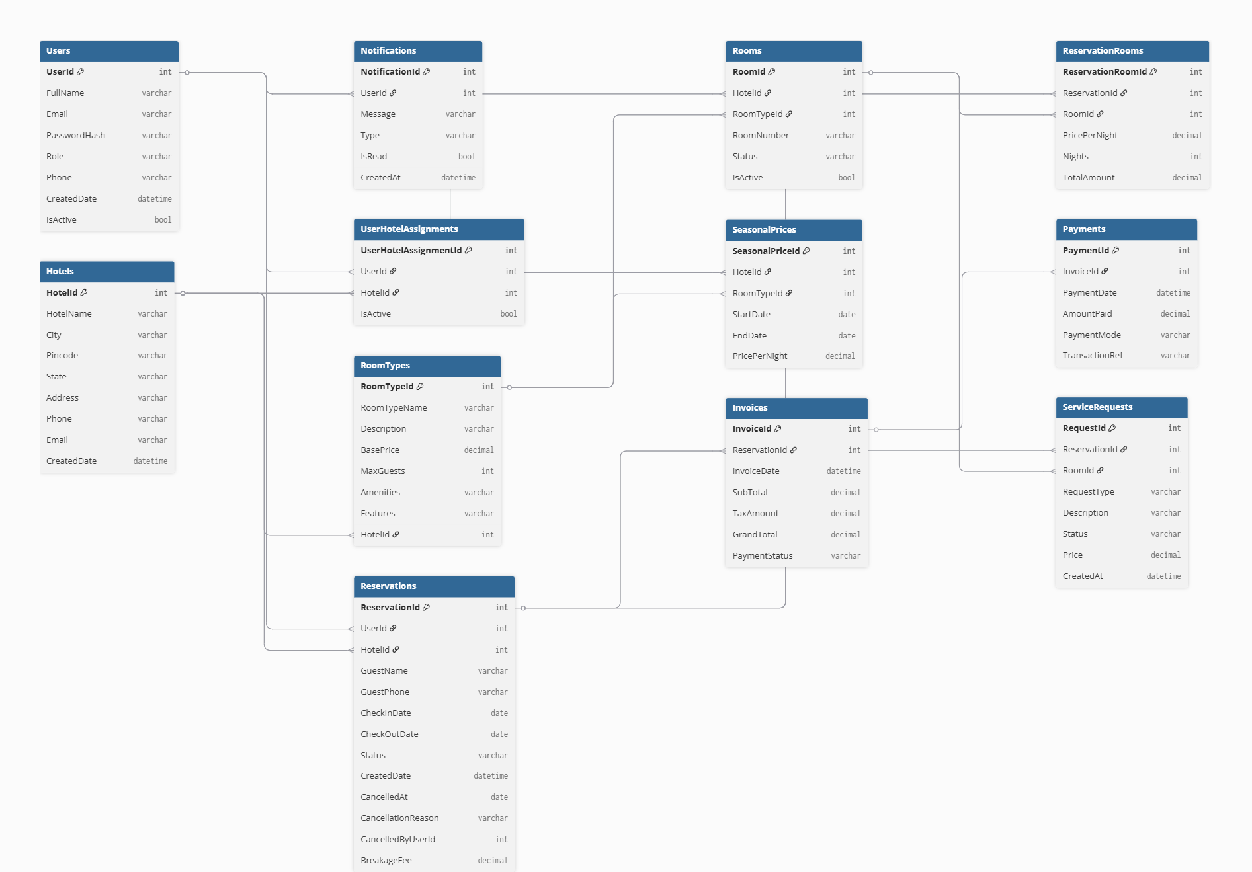
ER-DIAGRAM

Slide 11
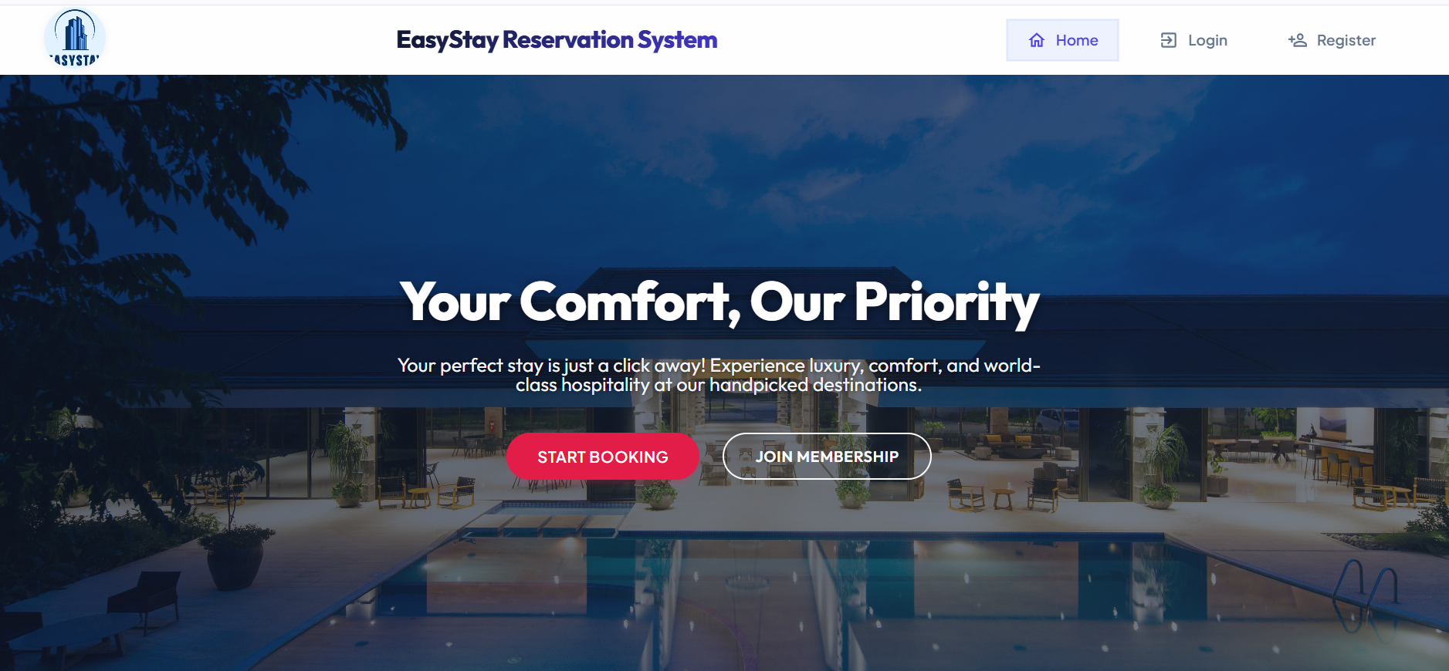
Home page

Slide 12
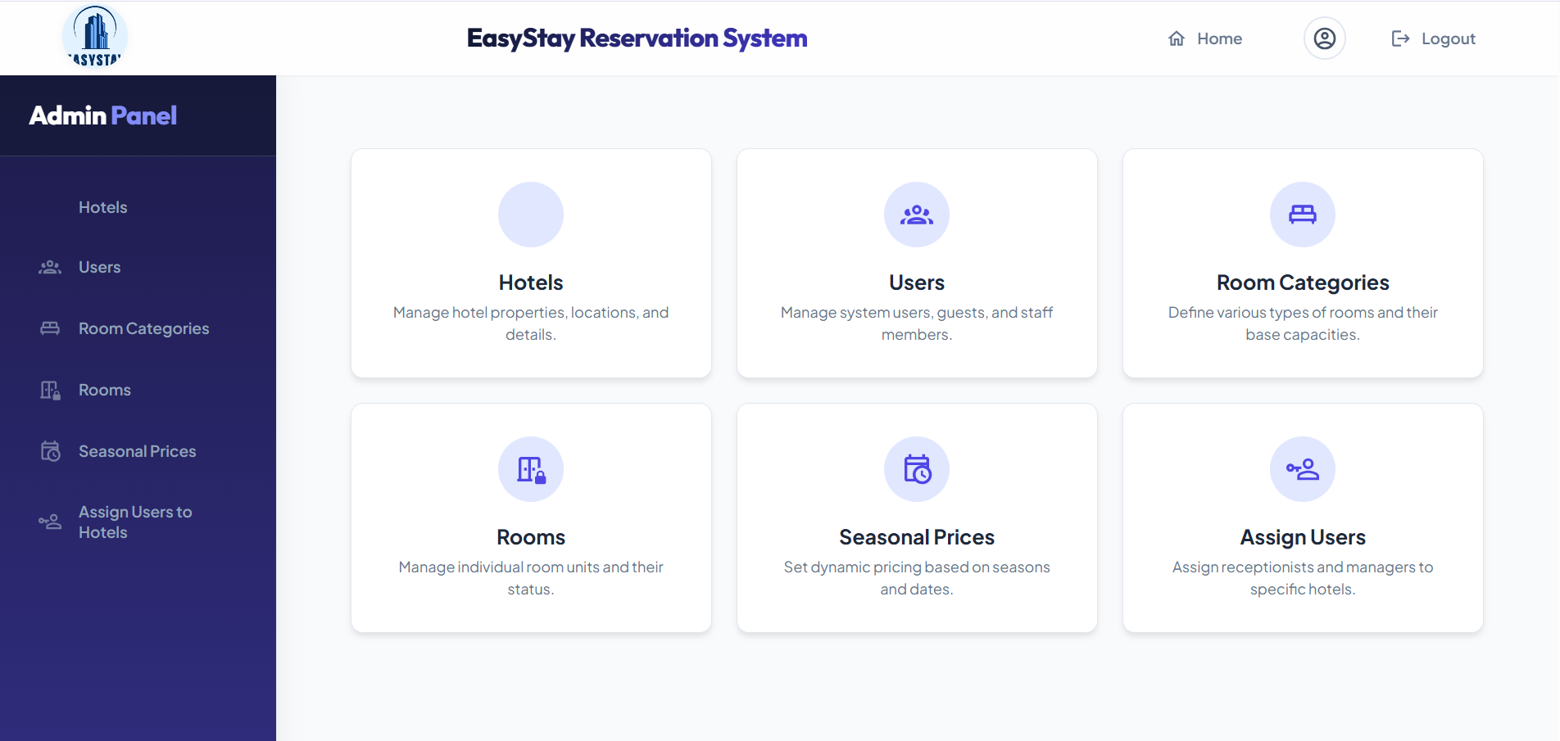
Admin dashboard

Slide 13
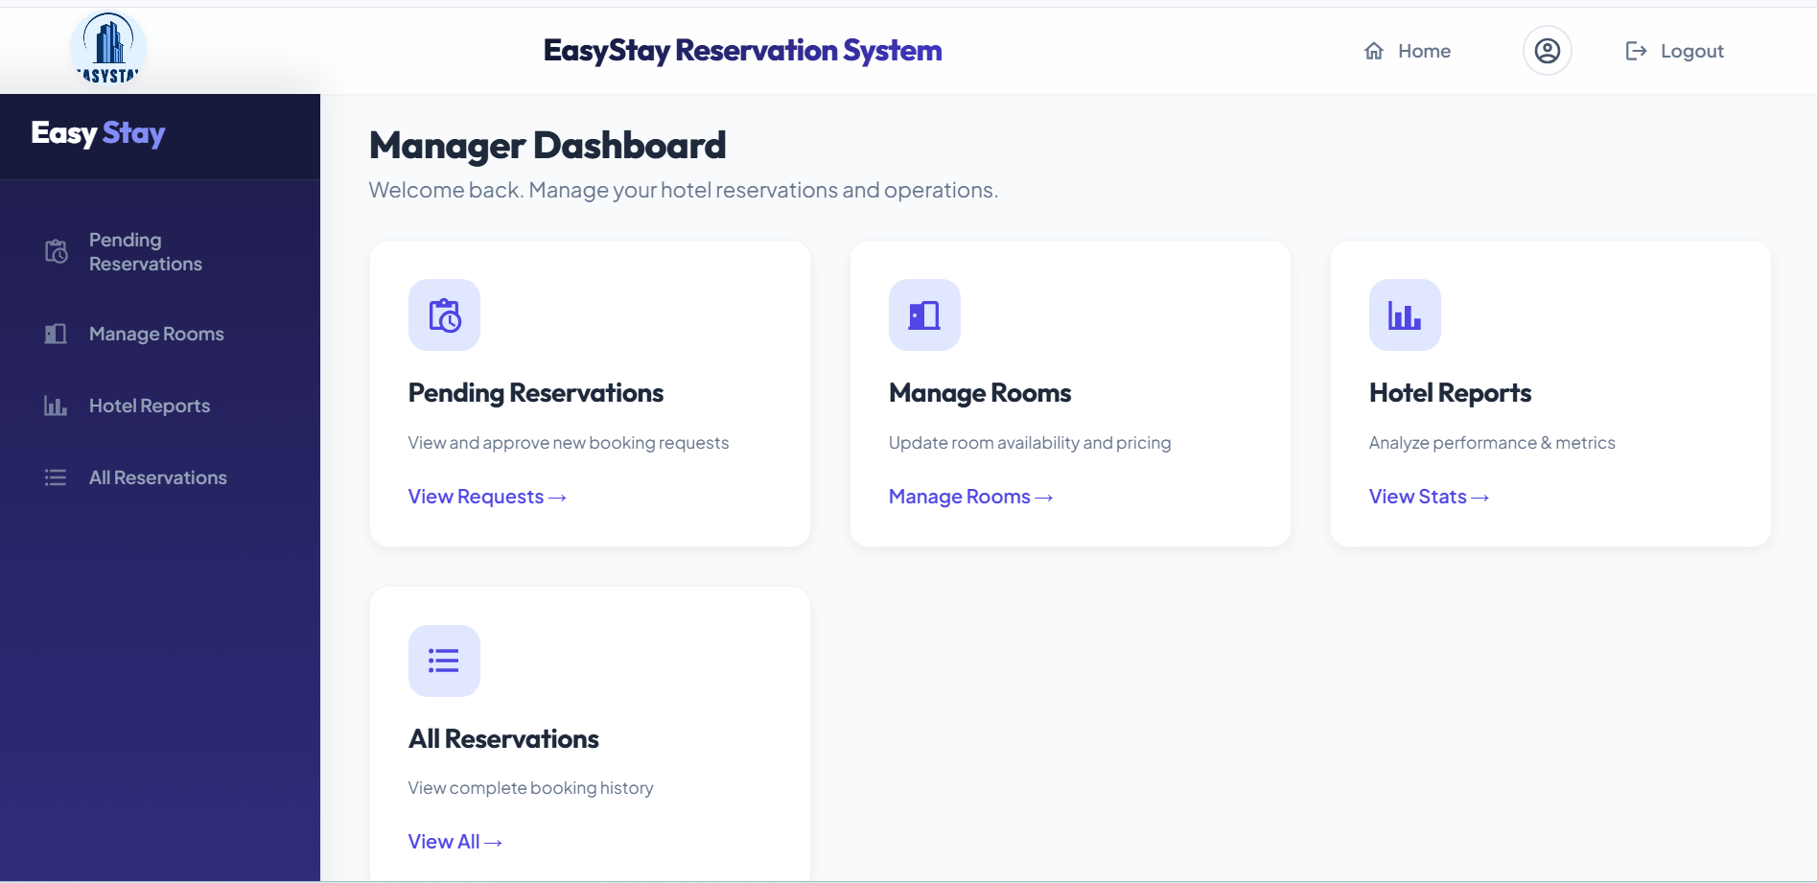
Manager Dashboard

Slide 14
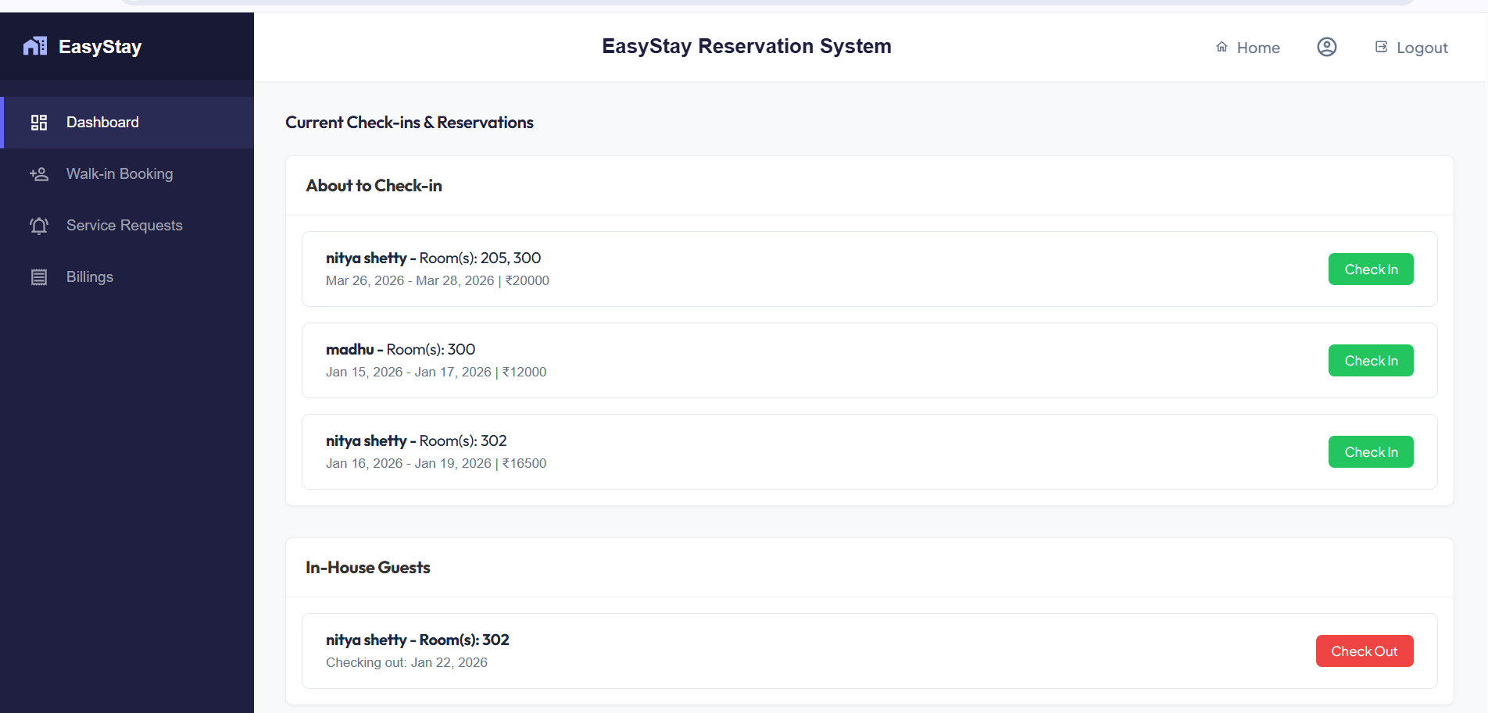
Receptionist dashboard

Slide 15
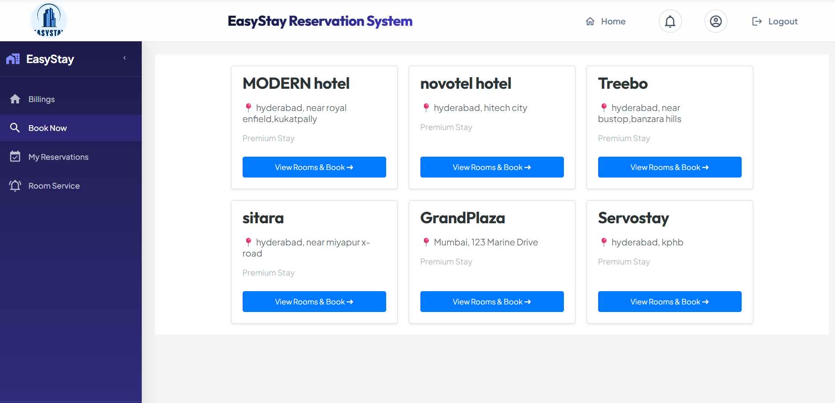
Guest dashboard

Slide 16
reservation booking lifecycle
guest selects a hotel

Slide 17
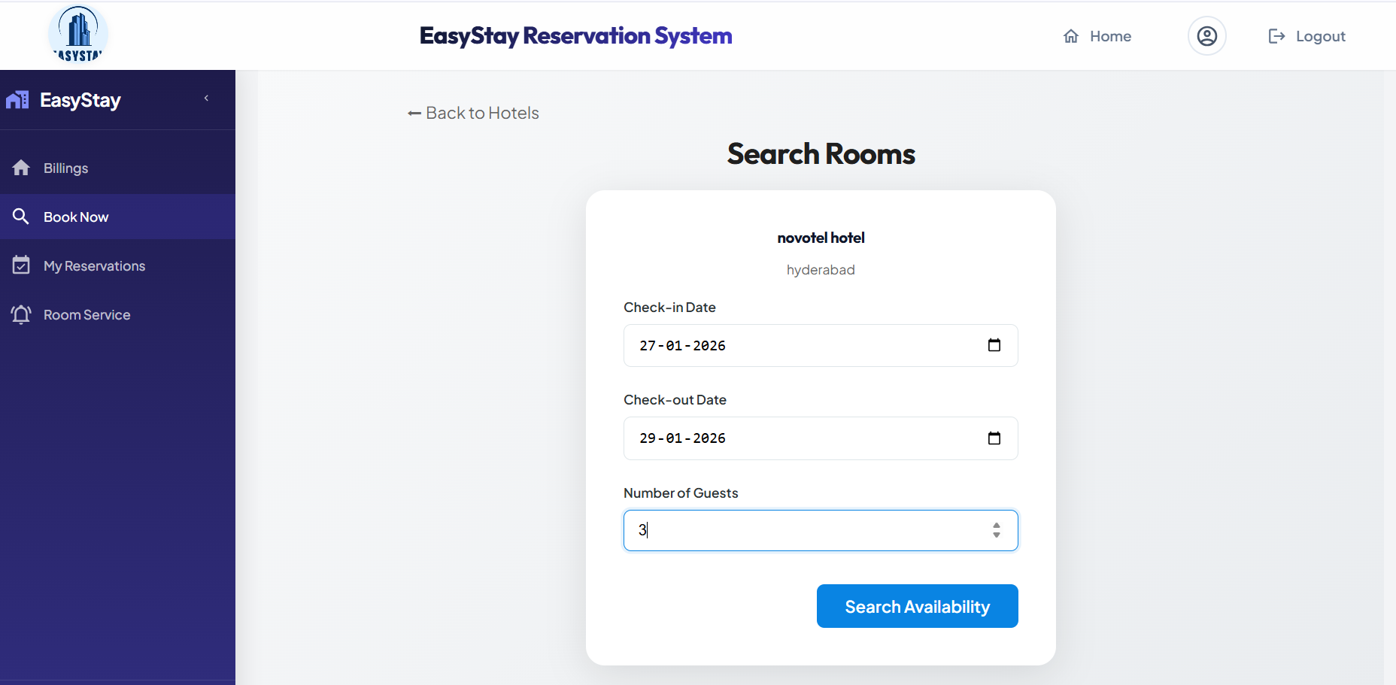
2.guest search for rooms according to check-in check-out dates and Number of guestsl

Slide 18
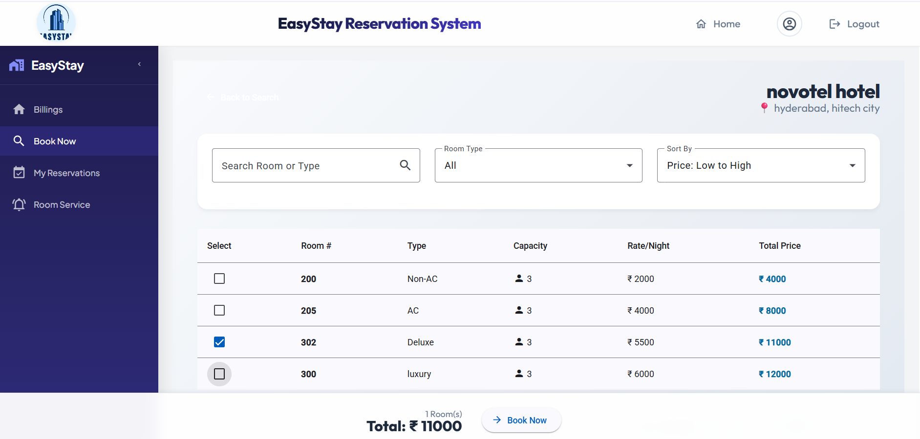
3.guest select rooms based on count of people and book the rooms

Slide 19
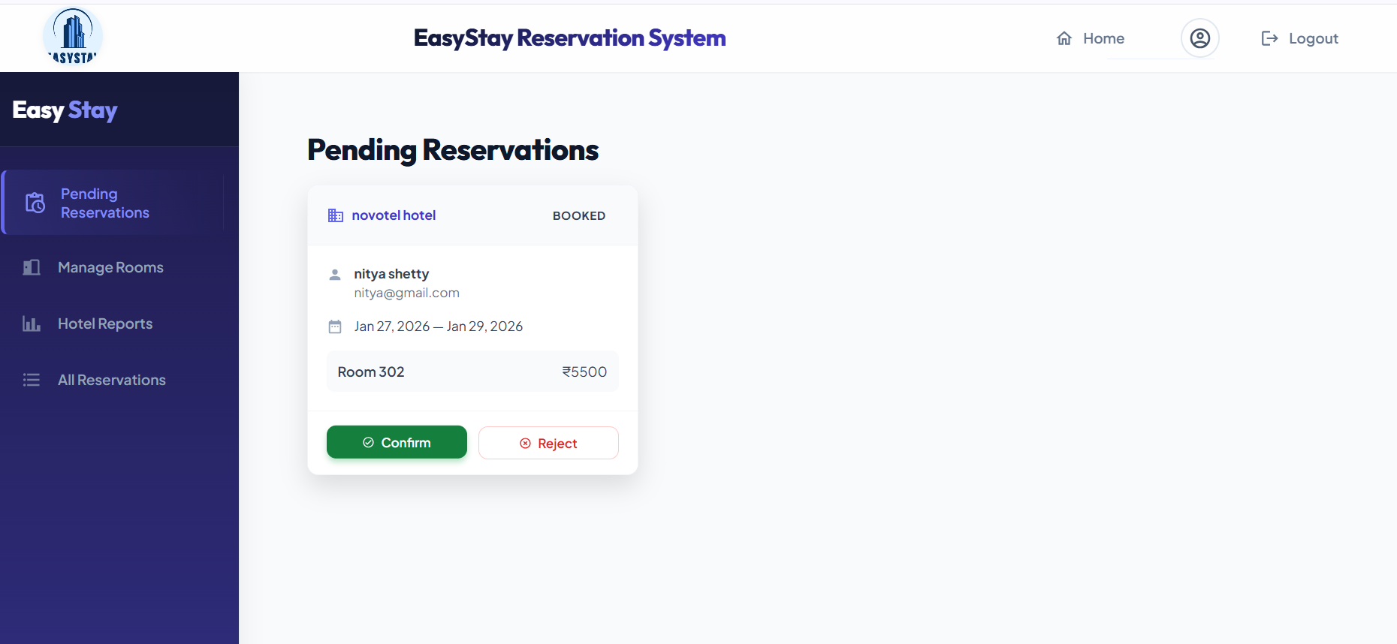
4.manager assigned with that hotel confirms or reject the booking

Slide 20
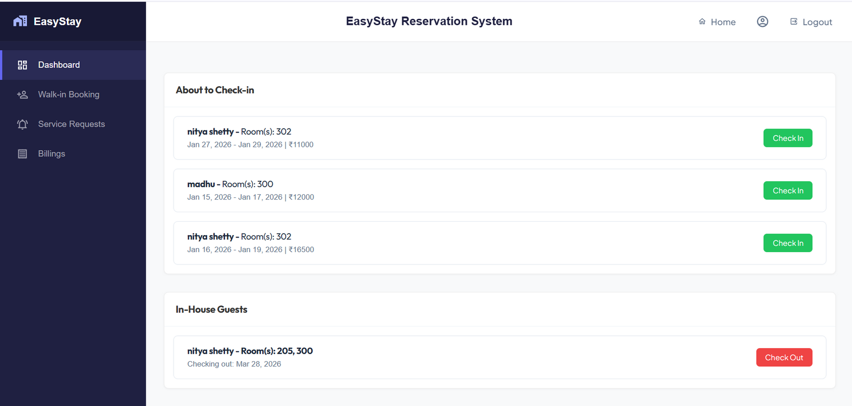
5.receptionist assigned to the hotel check -in the guest

Slide 21
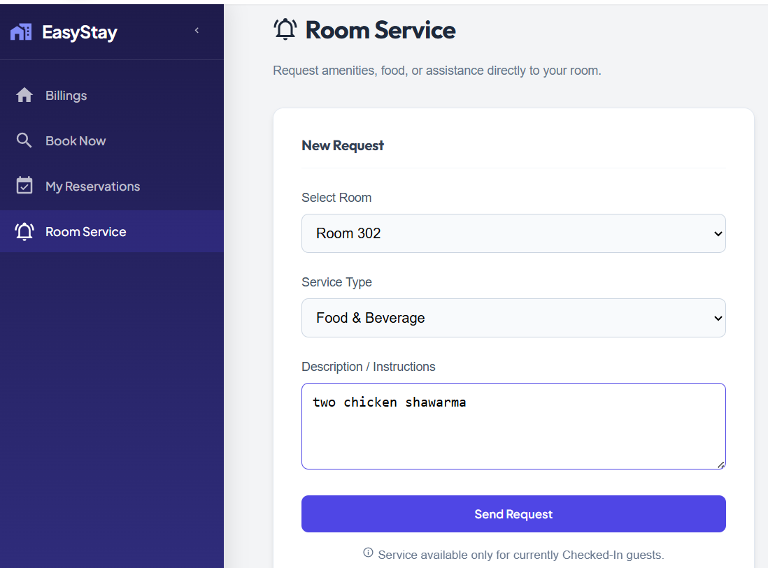
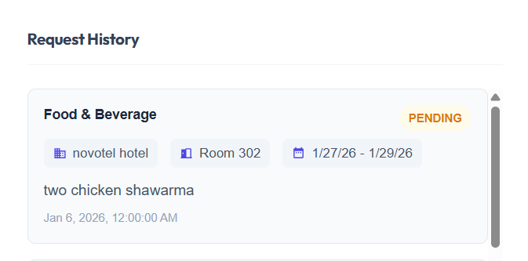
In this I have also added room services so that, when guest check-in then can request for services where in receptionist will approve and provide those by making additional charges
6. guest request for service
status of service is pending

Slide 22
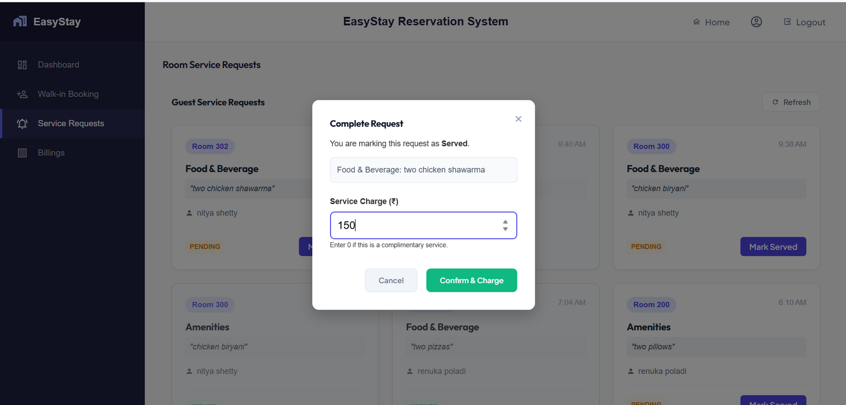
7.receptionist will approve by making additional charges on the service

Slide 23
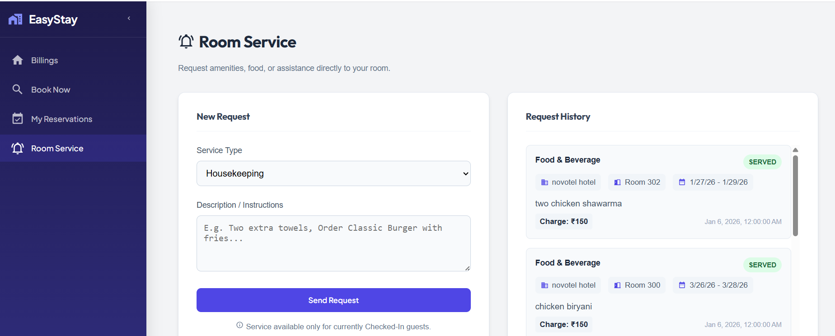
8.Service provided to the Guest , now status is served

Slide 24
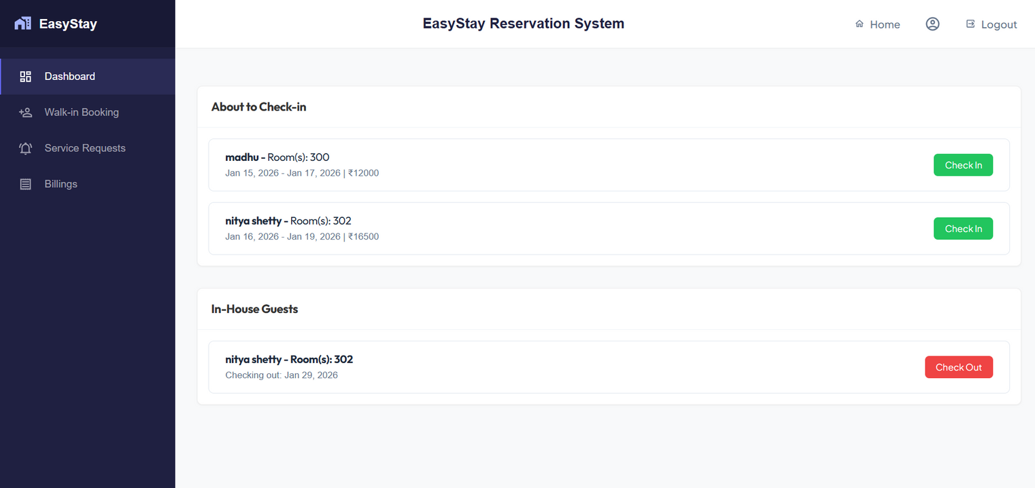
9.Receptionist check-out the guest

Slide 25
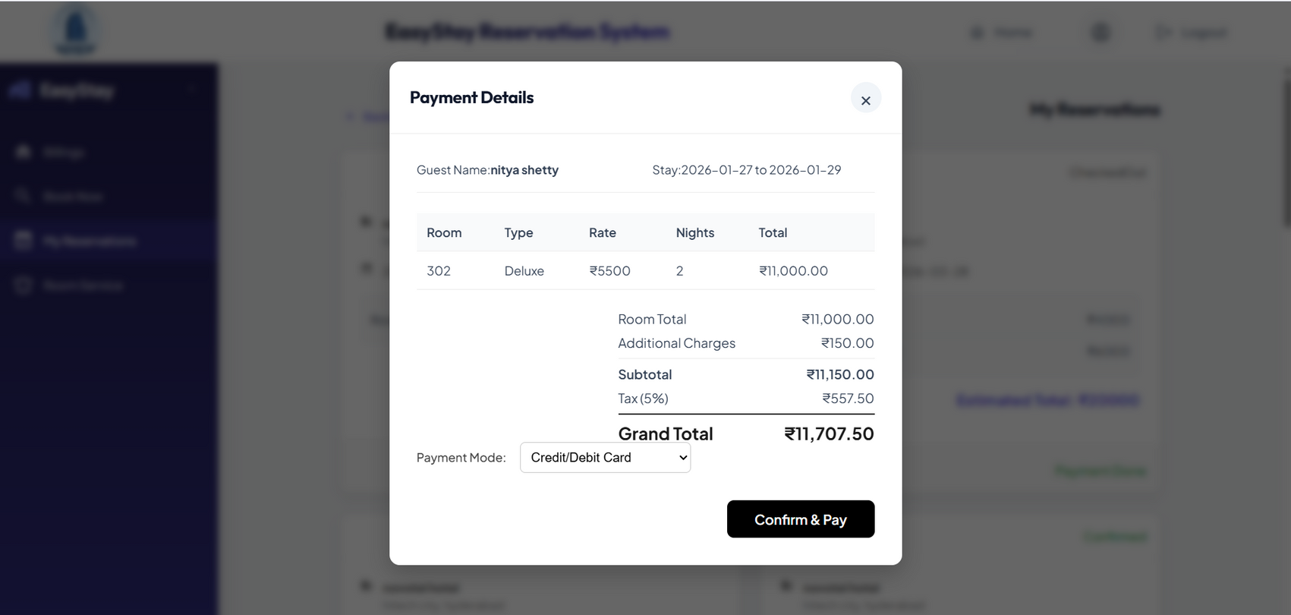
10.invoice preview after check-out (additional charges include service charges,breakage fee)

Slide 26
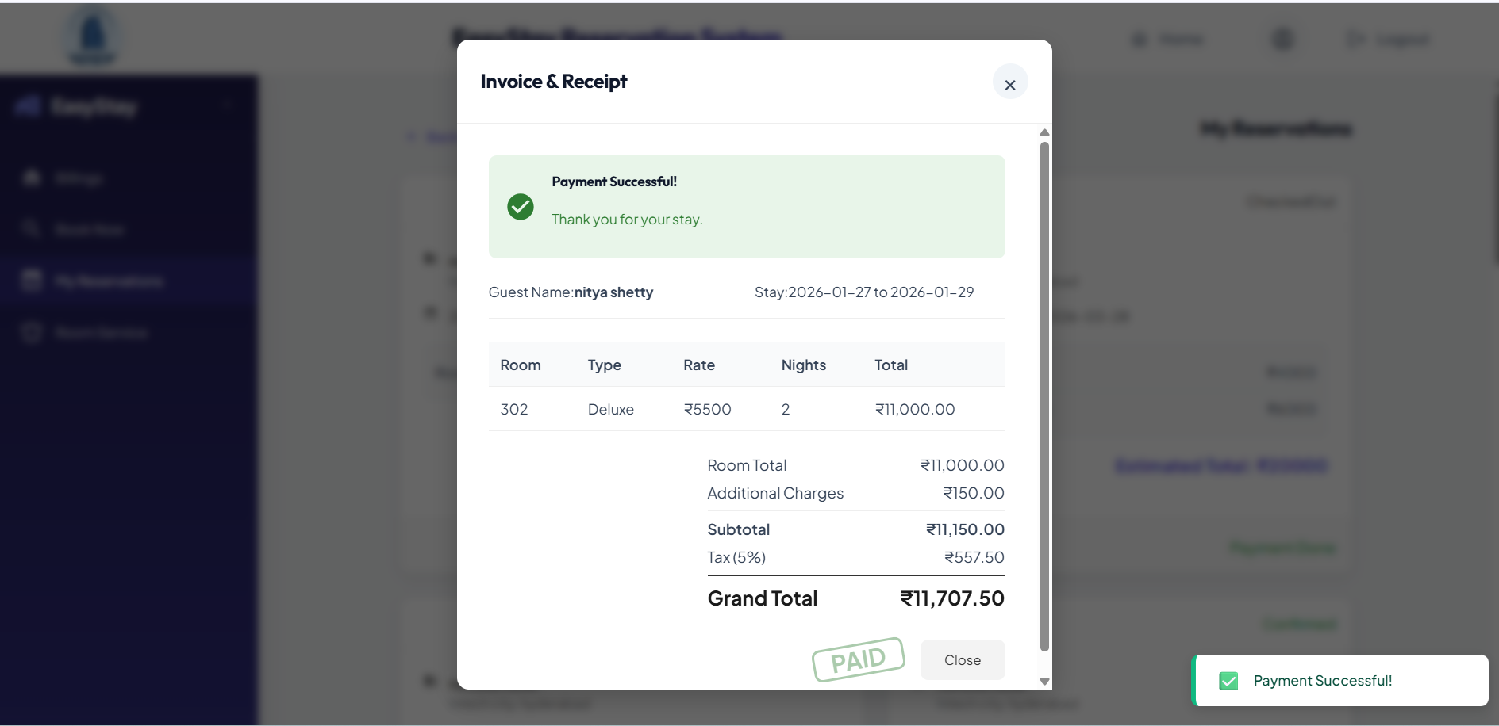
11.payment successful and billing is generated

Slide 27
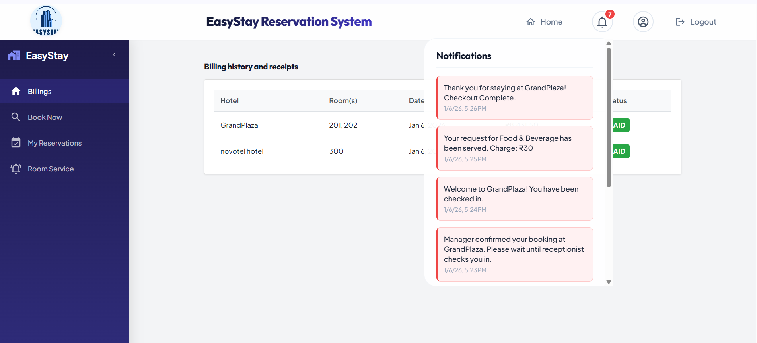
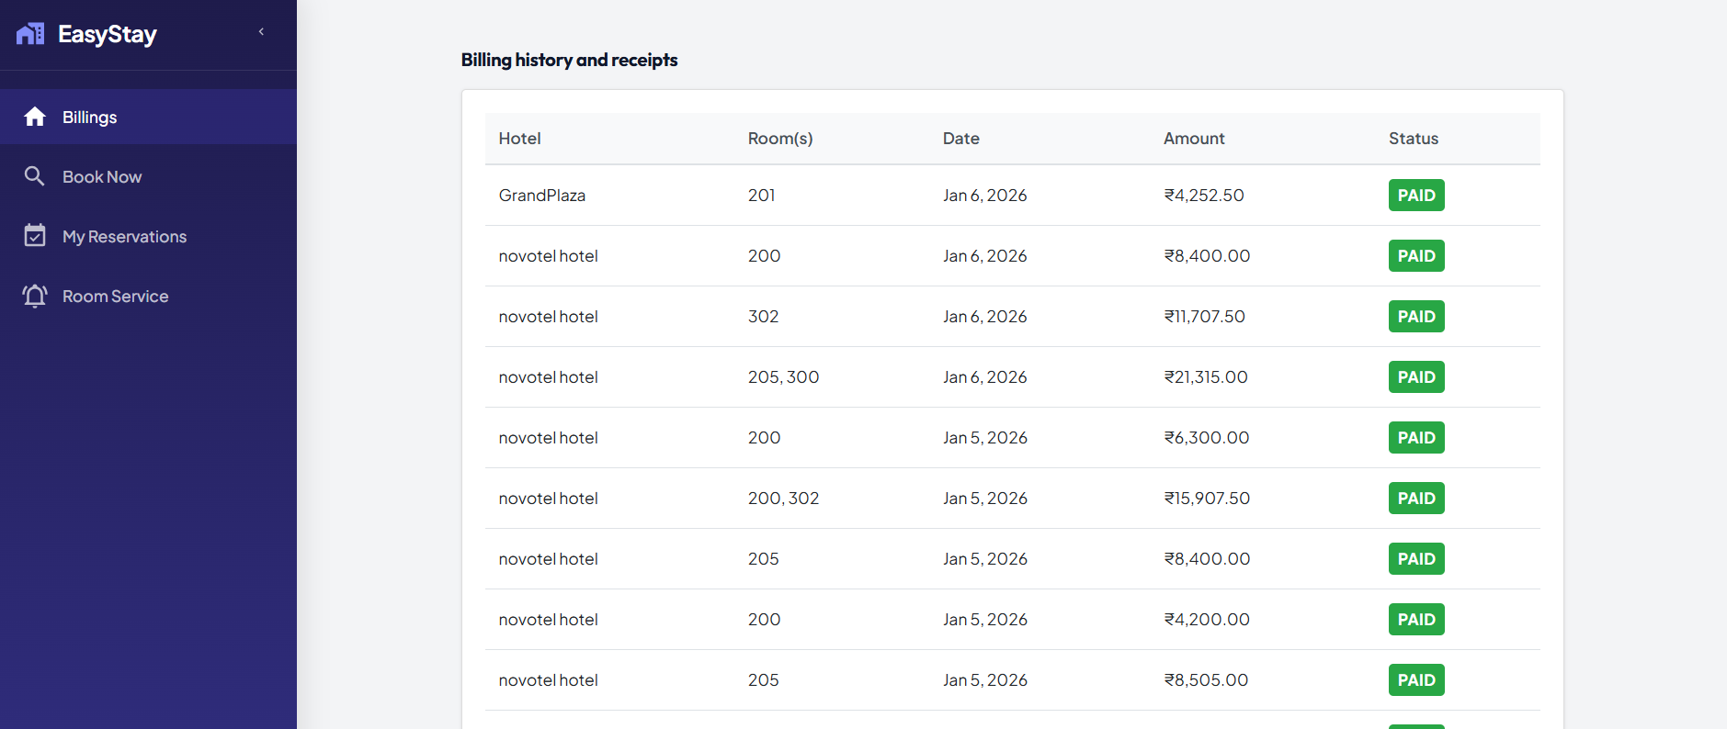
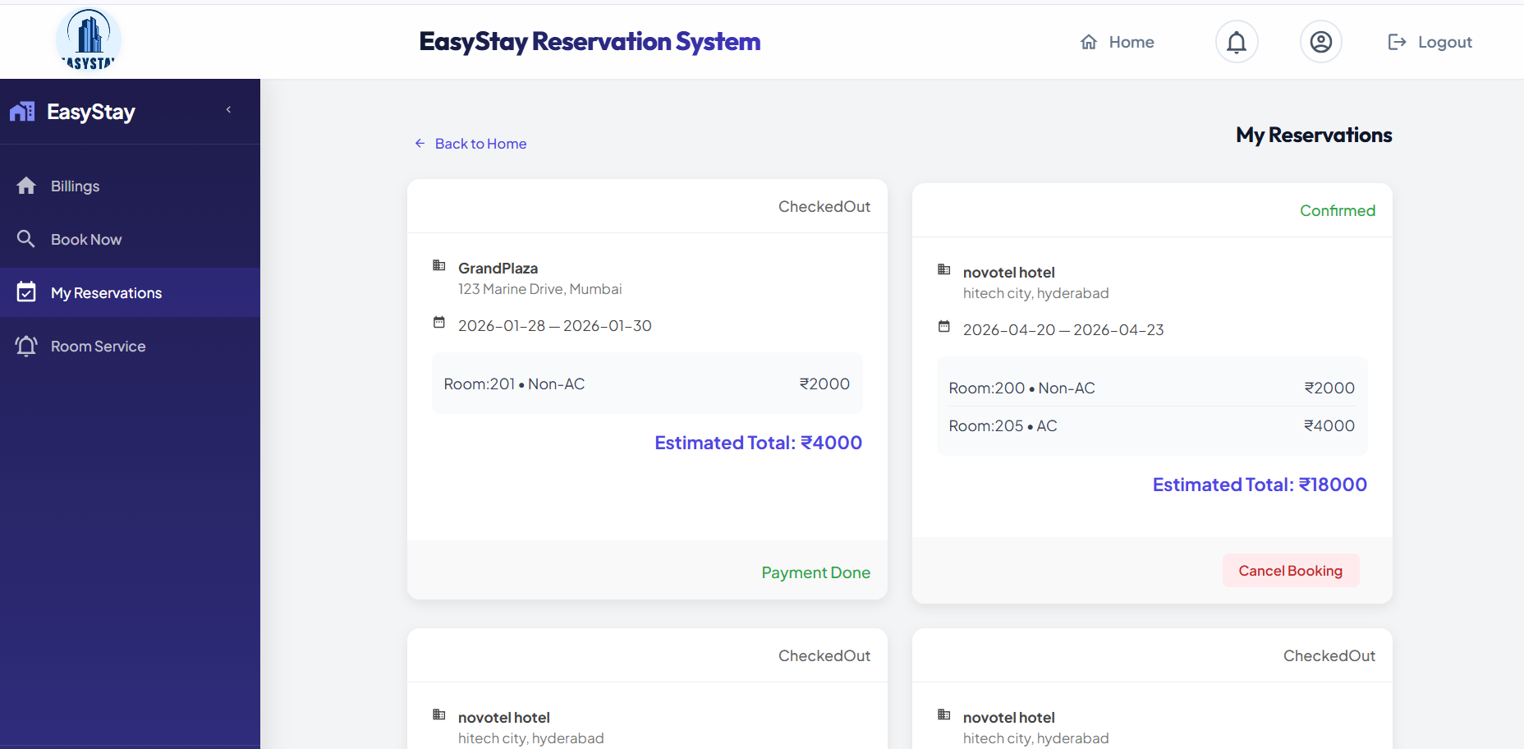
Notifications to the guest
Billing history that guest can view
Reservations of guest that guest can view

Slide 28
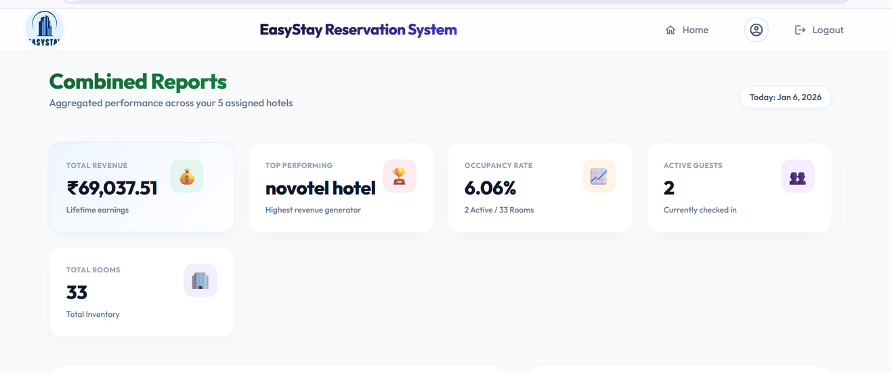
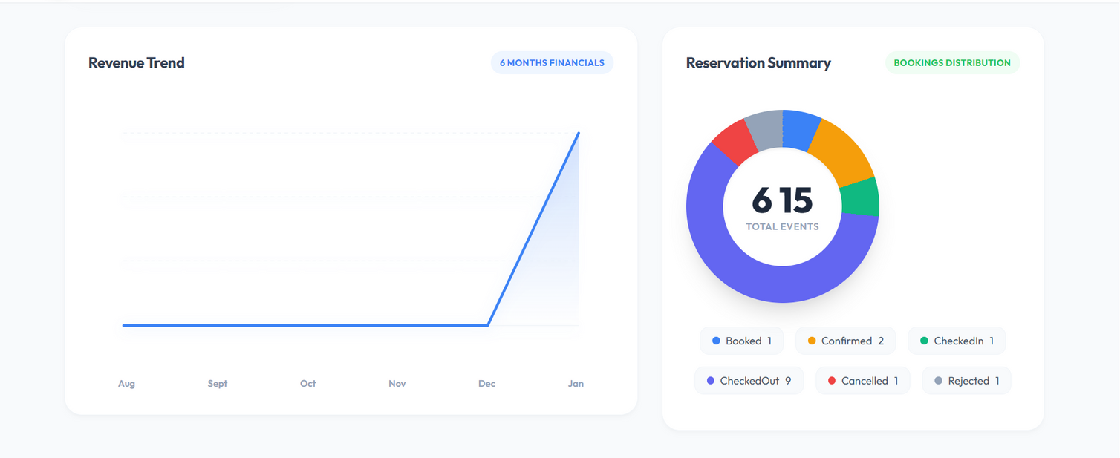
Reports & Analytics

Slide 29
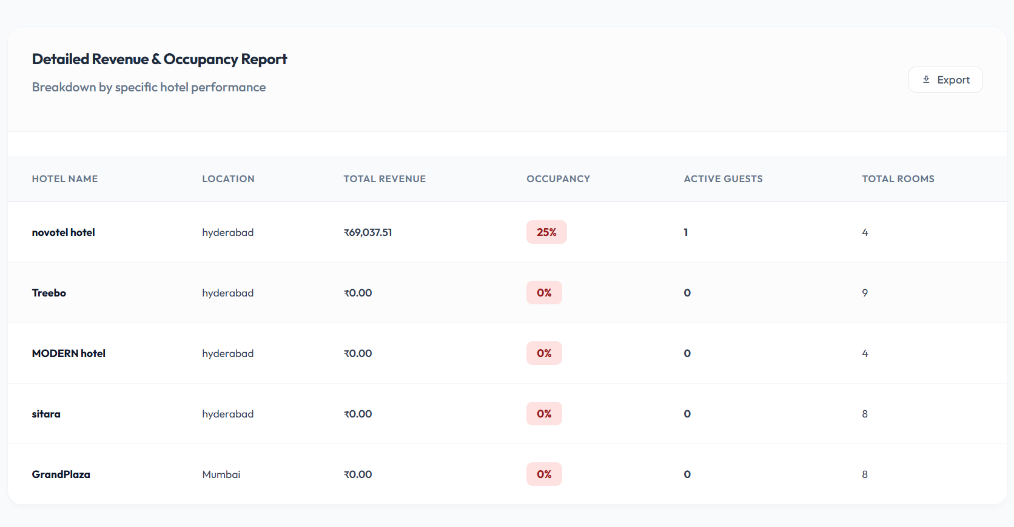
Reports & Analytics

Slide 30
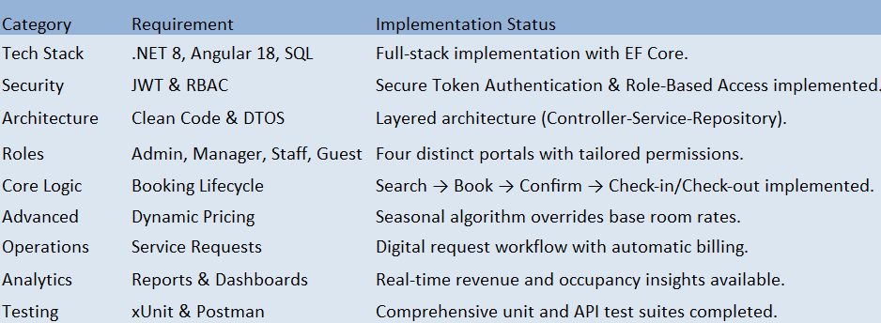
Functional Requirements & Implementation Summary

Slide 31
Results and Achievements
Guaranteed Booking Integrity: double-booking prevention through strong validation logic.
Secure RBAC Architecture: JWT-based role security for Admin, Manager, Receptionist & Guest.
Seamless Role Workflow: Guest actions instantly reflect in Reception & Billing modules.
High-Speed Analytics: Real-time dashboards powered by optimized LINQ queries.

Slide 32


Slide 33


